Slide 1

Vivino Portal Proposal
Strategic Brand and Retail Producer Partnerships

Slide 2

Current Client Experience

Slide 3
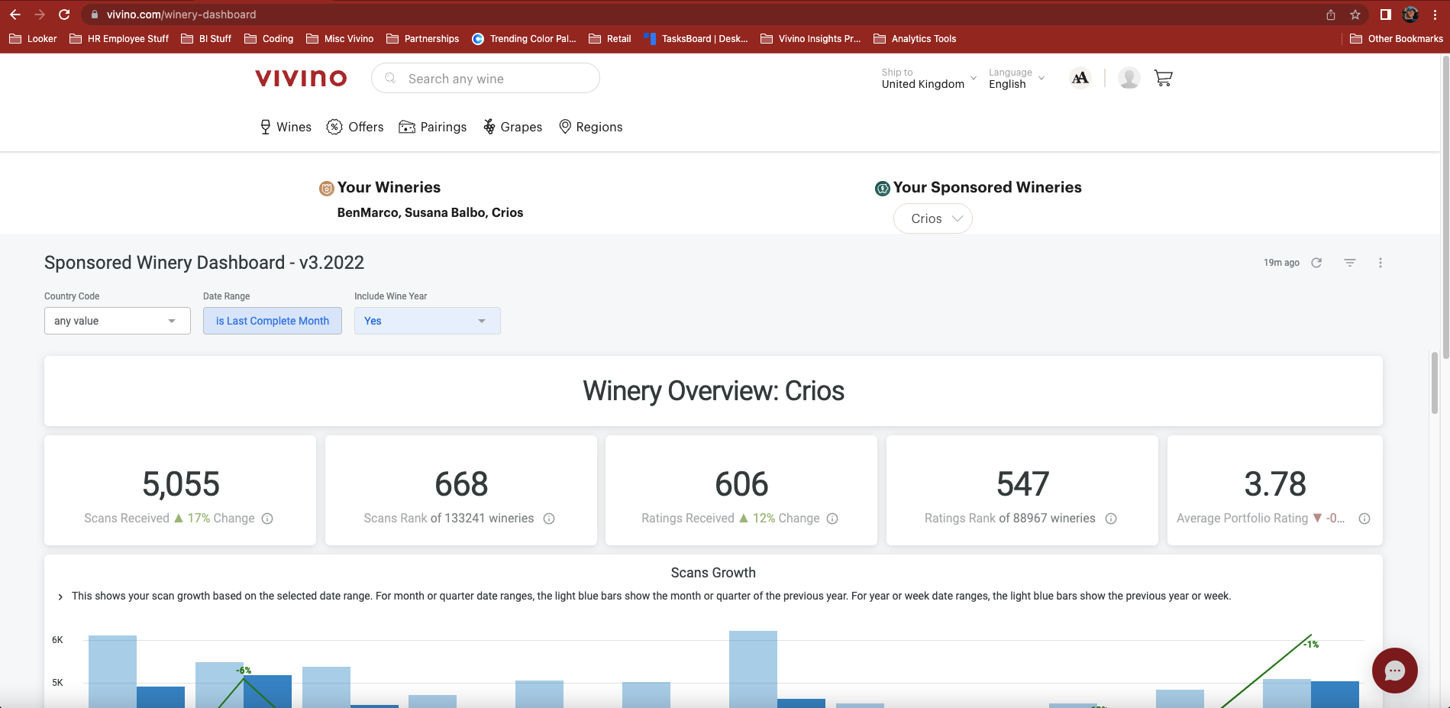
Sponsored Partnerships - Winery Dashboard

Slide 4
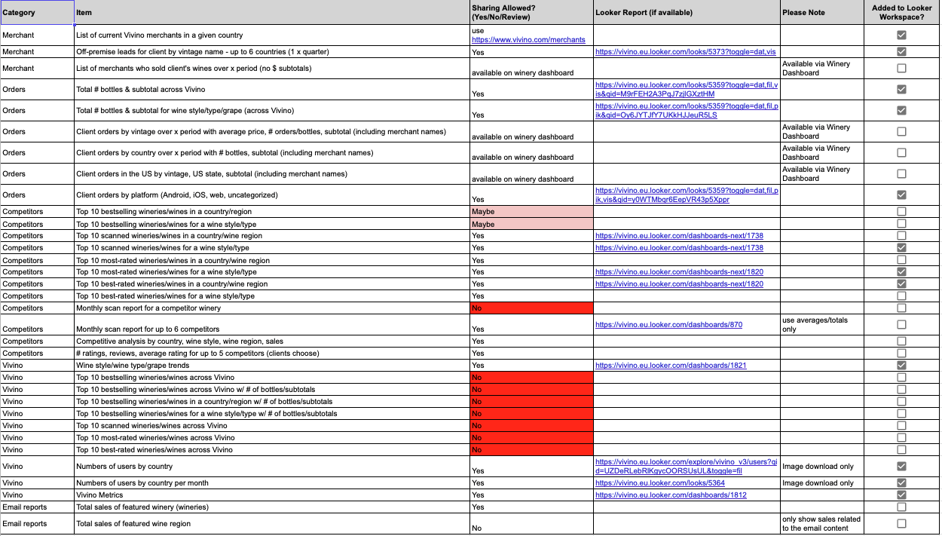
Sponsored Partnerships - Custom Reports

Slide 5
Vivino Portal:
A Curated Client Experience

Slide 6
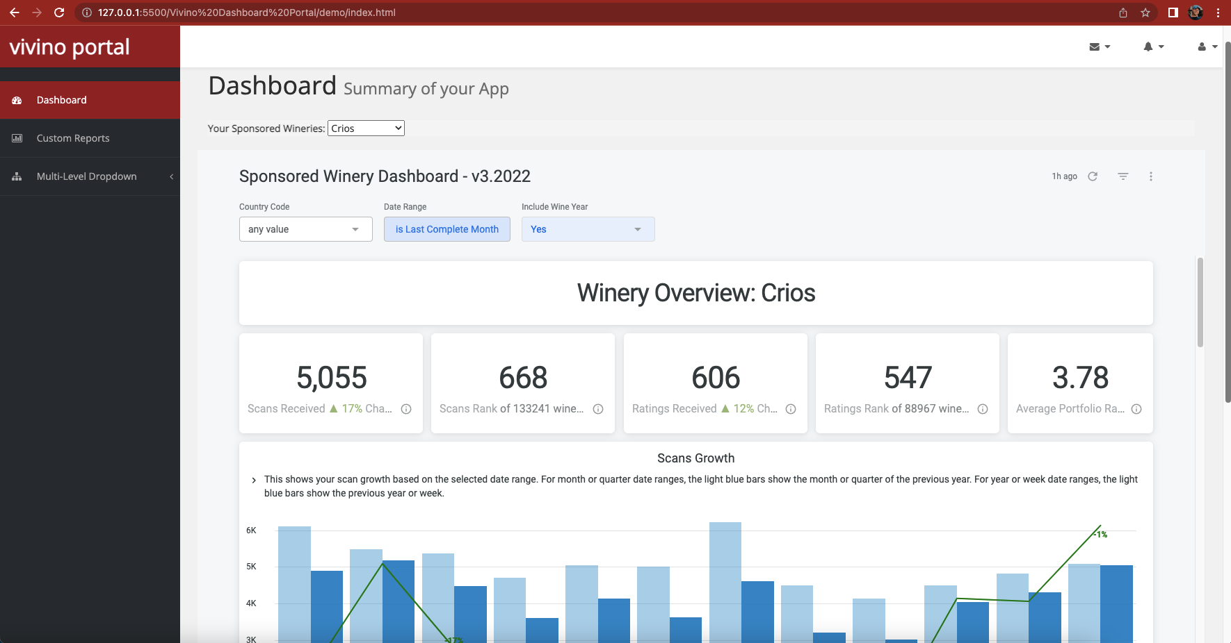
Sponsored Partnerships - Winery Dashboard

Slide 7
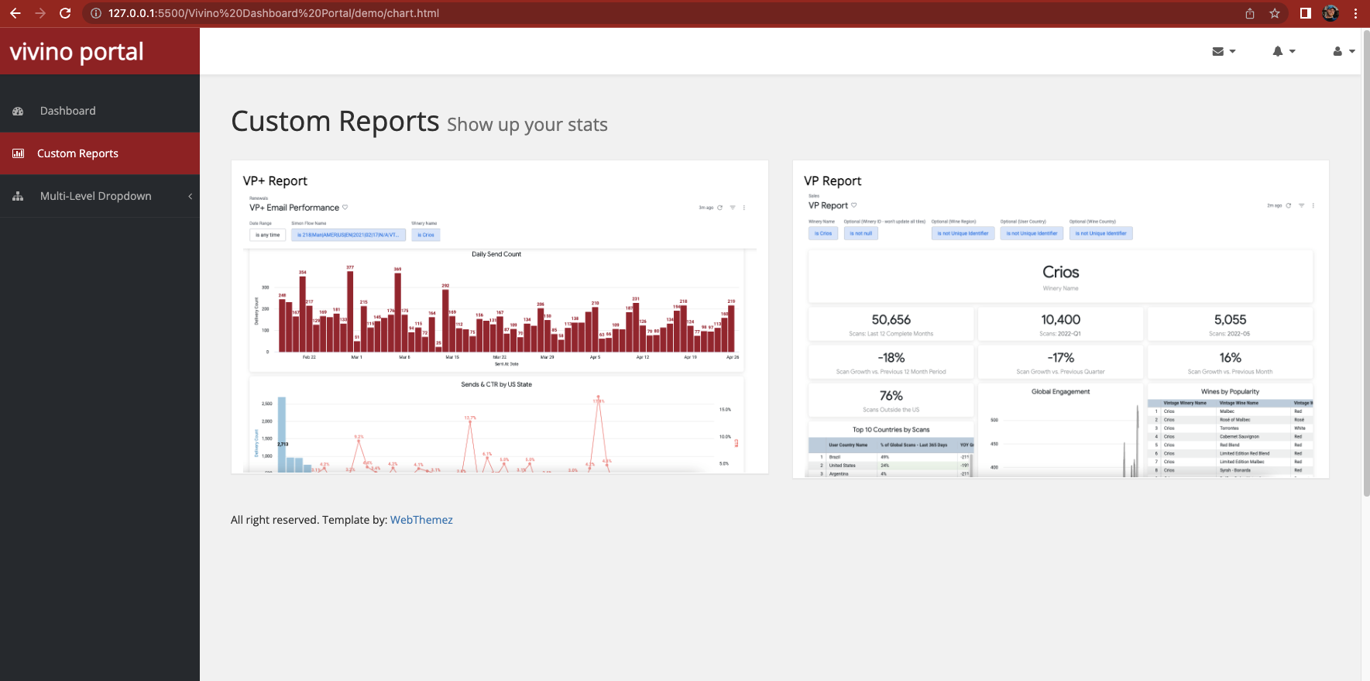
Sponsored Partnerships - Custom Reports

Slide 8
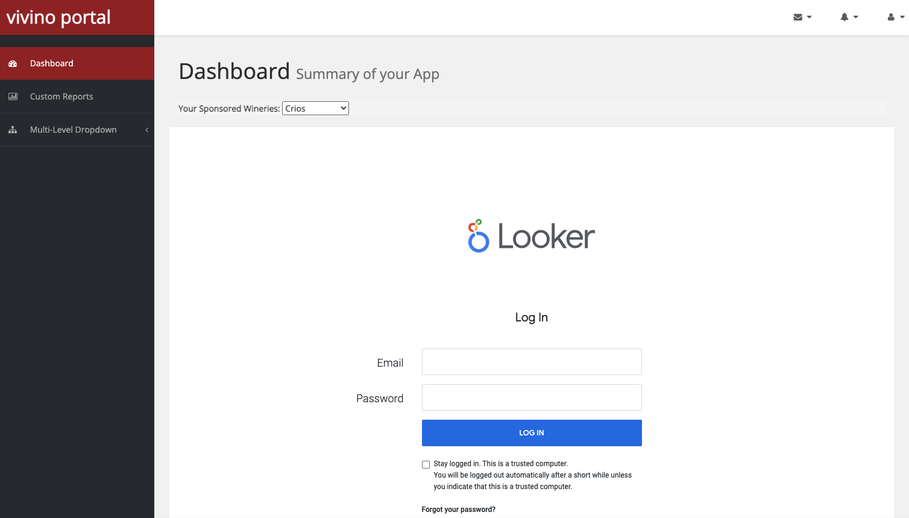
Embedding Looker in a Webpage
https://docs.looker.com/sharing-and-publishing/embedding#enable_login_screen_for_private_embeds
Notes:
Looks and Dashboards can be embedded in webpages either using private embedding (shown here) where a user needs to provide credentials to log-in. They can also be embedded using SSO (single sign on) but this would be a link to a specific Look/Dashboard so could be problematic where we want to control parameter inputs through user attributes.

Slide 9

Domain Hosting
vivino.one | $12/year
vivino.tech | $40/year
vivino.live | $20/year
vivino.ceo | $100/year
vivino.me | $20/year
vivino.plus | $40/year
vivino.services | $30/year
vivino.solutions | $20/year
vivino.tools | $30/year
vivino.works | $30/year

Slide 10

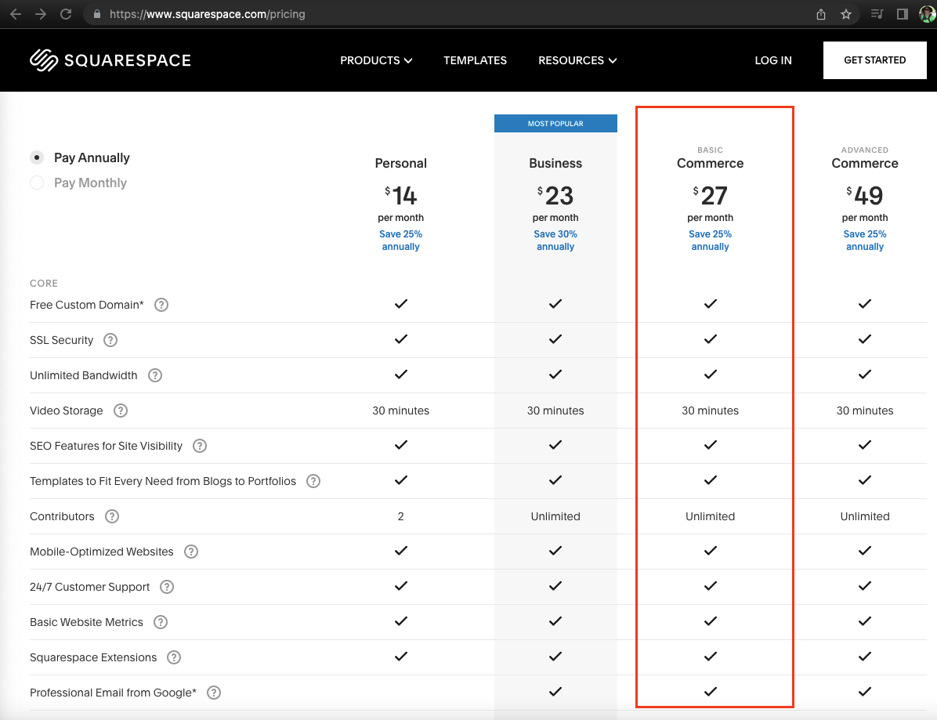

Web Hosting: Squarespace
https://www.squarespace.com/pricing
Notes:
The Commerce account allows for Customer Accounts, which would be needed to make sure only logged-in users can access the Looker reports/dashboards.

Slide 11
Thank you

